Slide 1
SPACECLUSTER

Slide 2

Mission statement: To help data researchers use data more efficiently.

Slide 3
The problem
It is hard to find relevant data sets on data.nasa.gov.
Making logical connections between datasets is a challenge.

Slide 4
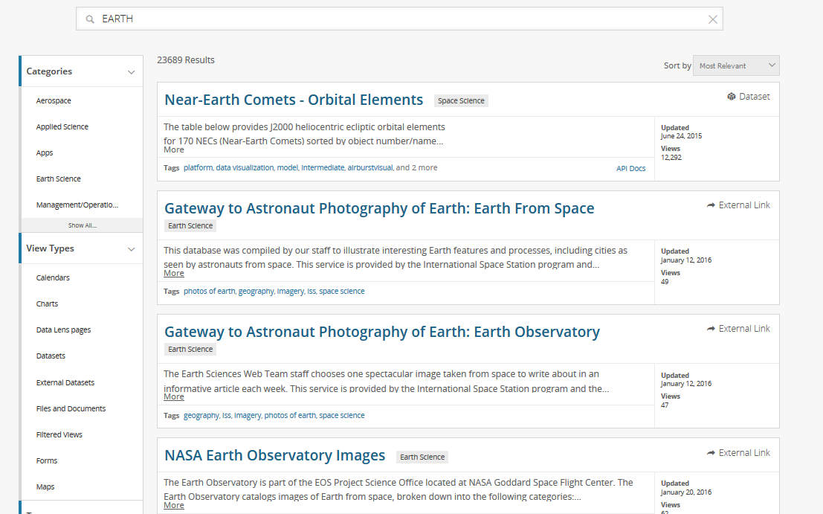

Slide 5

The solution
Artificial Intelligence-powered search engine to help data researchers find relevant data.
It maintains data integrity between data sets using keywords frequency.
Provides interactive visualization of keywords and datasets.

Slide 6

The technology:
LDA model (clustering) + D3.js (visualization)

